Slide 1

Smart Learning School
Dan Conley
Founder
smartlearningschool.com
contact@smartlearningschool.com

Slide 2
Outline
Metacognition: What and why?
Origin Story
Platform & Programme
The Evidence

Slide 3
Metacognition:
What & Why?

Slide 4
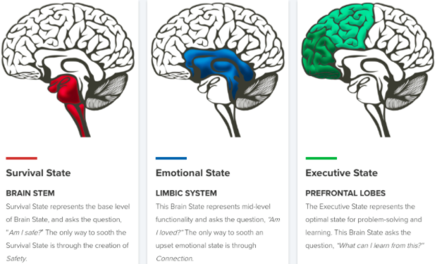
What is Metacognition?
"Thinking about thinking"
Characteristic of the most effective learners
Based on self-awareness / reflection
Relies on diverse, well practiced strategies

Slide 5
What does it mean for Students?
Establish the foundations of learning
Learn which strategies to use when
The right practise to improve recall / performance

Slide 6
Origin Story

Slide 7

“I did LOADS of revision and still got a crap grade!”
“Nah, I don’t revise anymore. I’ve realised it doesn’t make any difference.”
“My brain just won’t focus long enough to take anything in.”
“My anxiety goes through the ROOF as soon as I open a textbook at home.”
“Sir - I hate revision so much, that I actually clean my room instead!”
“I’m wired for scrolling, not studying.”

Slide 8
“I can’t have done that bad. I stared at my notes all weekend!”
“I literally can’t do silence anymore. I need noise just to think.”
“Every time I sit down to do work, I get a notification and BOOM — I’m gone.”
“I thought I was revising — turns out I was just staring aggressively at paper.”
“I sit down to do homework and somehow I’m on YouTube ten minutes later”
“Sir, me and Charlotte LOVE revising together… Well, we like the bants, anyway.”

Slide 9
“Made these beautiful flashcards. Failed the test. But honestly, sooo beautiful. ”
“I revise with music in the background. And 14 tabs open — is that bad?”
“I often end up using independent study time to just contemplate life instead”
“My technique? Cry a bit, highlight everything, Google ‘revising in your sleep’.”
“What, just sit there and read? From a book? Are you mad?”
“My mate helps me learn, innit. He’s called Chap GPT”

Slide 10
“Why is it that I feel like I’ve already failed before I’ve even started?”
“Everyone else seems to get it — maybe I’m just thick.”
“Even when I try really hard, it feels like my brain is full of fog.”
“Not being funny sir, but memorising stuff?! We’ve got the internet now.”
“Check [out] my GCSE plan. Cans of monster, night before - smash it!”
“How come no one ever teaches us how to actually learn this s**t?!”

Slide 11
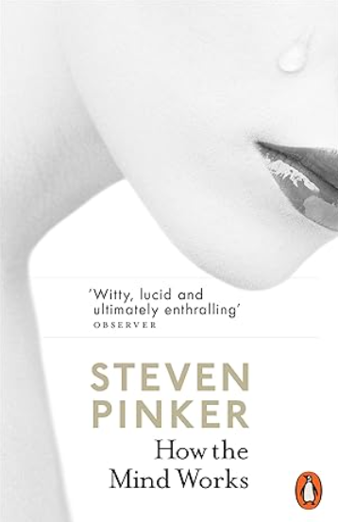
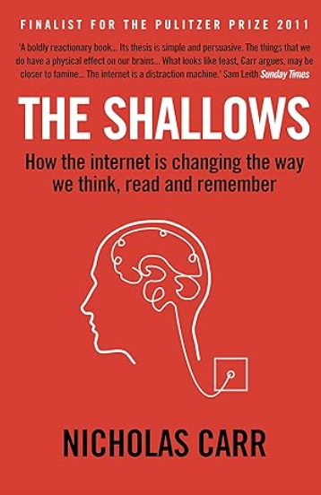

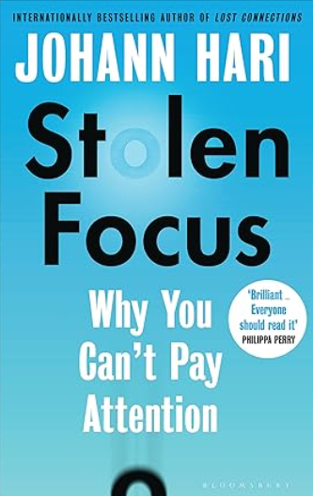

Slide 12
The Problem
Often students are told: ‘revise for the test’
Very rarely does anyone tell them how
How many of us were told how?
Was this part of your teacher training?
Yet, it’s 50% of teaching and learning

Slide 13
The Problem (continued)
Tutors and teachers are time poor
Metacognition is complex
Best strategies depend on what you’re learning
There’s lots of quackery & BS out there!
It can’t be last minute in Y11!

Slide 14
The Solution
Start in Y7
Recursive - revisiting themes each year
Fortnightly sessions - 15 mins
No teacher prep / workload
Snappy, relevant, useful
Videos and discussion (not book work)
Pledges for change!

Slide 15
The Platform & Programme

Slide 16
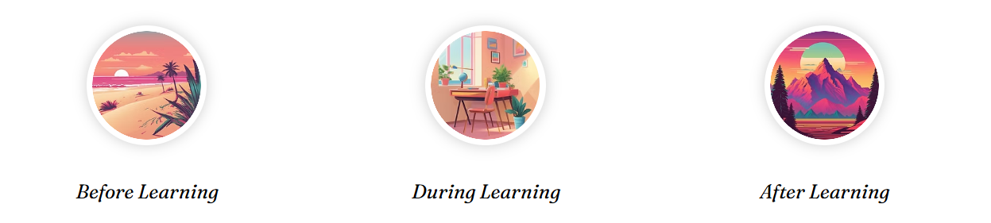
www.smartlearningschool.com
Am I ready?
Which strategy?
How to practise?

Slide 17
Your Working Memory Digit Span!
21978
630986
5480329
15068715
925481367

Slide 18
9805 1174 7101 1022

Slide 19
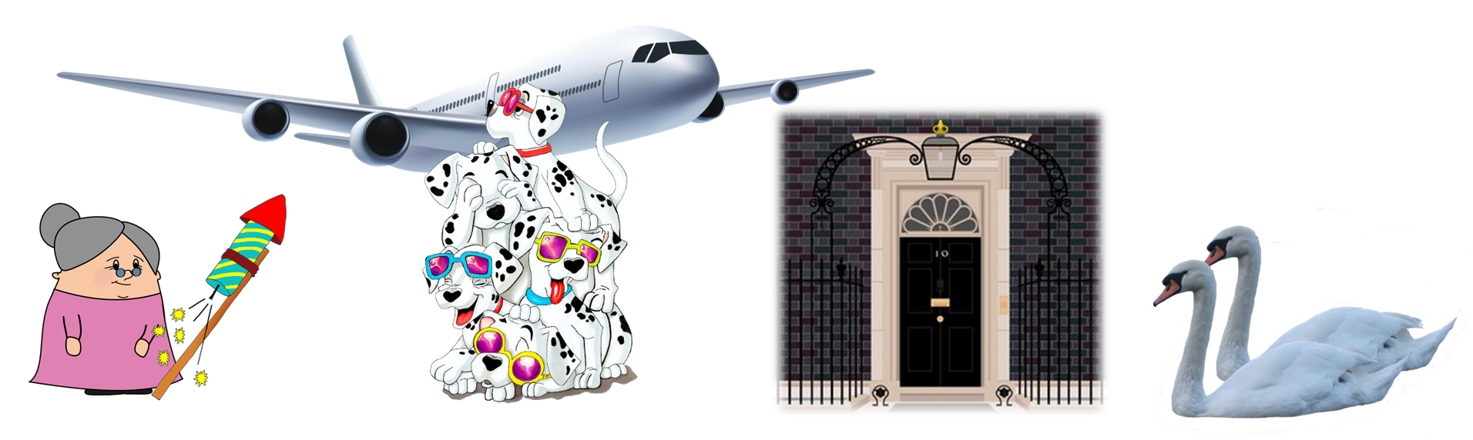
9805 1174 7101 1022

Slide 20
9805 1174 7101 1022

Slide 21
9805 1174 7101 1022

Slide 22
The Evidence

Slide 23
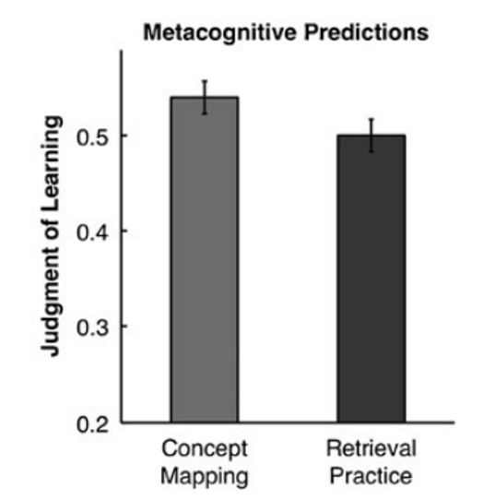
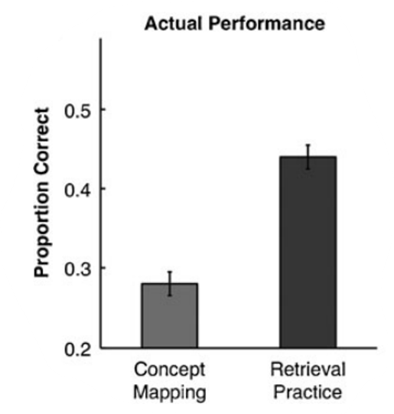

Slide 24

The Illusion of Mastery
When we read or copy, we recognise
We mistake recognising for knowing
→ Over-confidence, under-performance
Why do we all do it?
Knowing lots quickly feels good

Slide 25

What does the Evidence say?
Toolkit

Slide 26
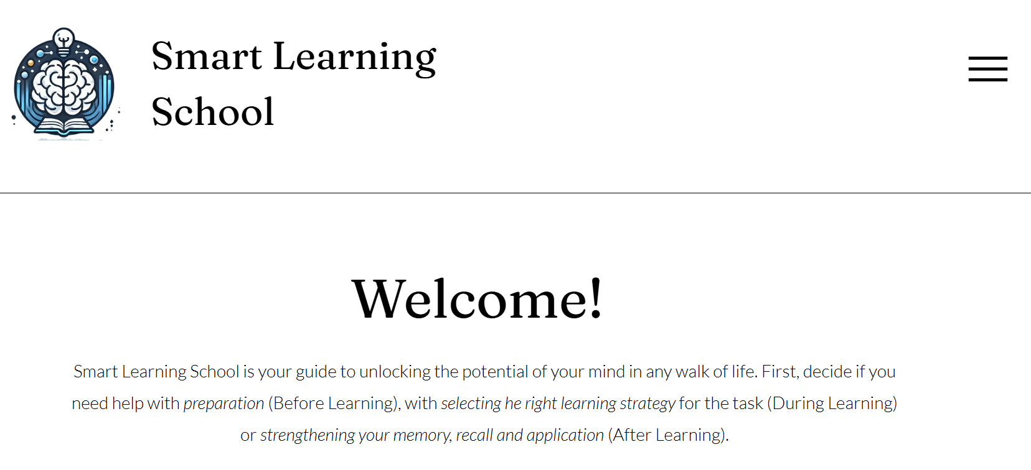
Link here

Slide 27
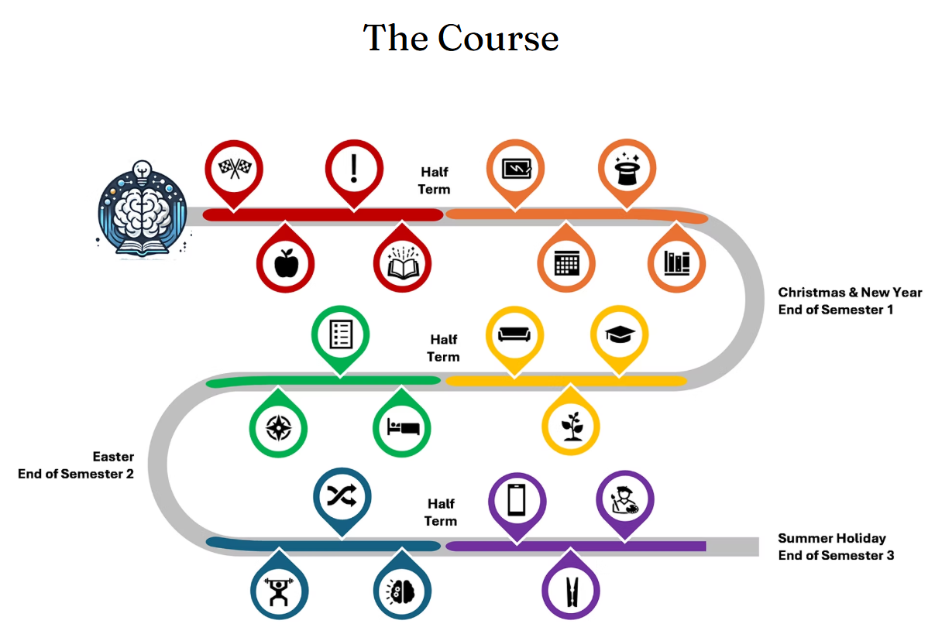
Link here

Slide 28
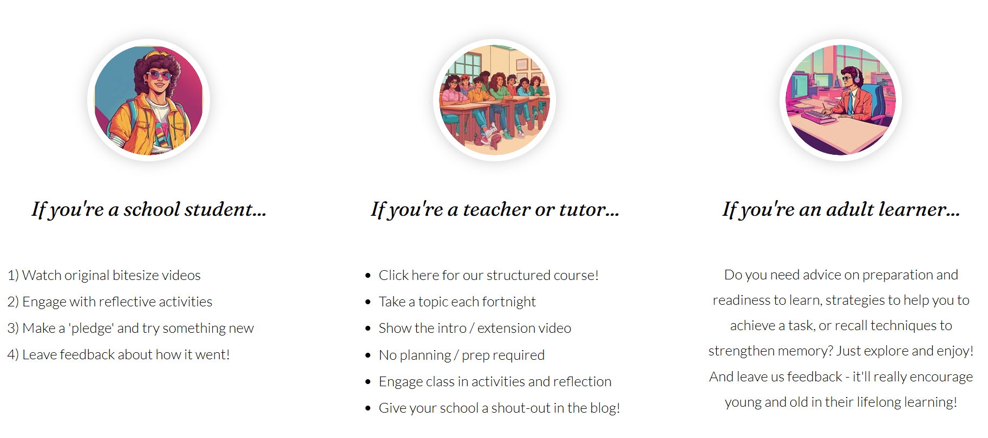

Slide 29
Takeaways
Students need help!
Am I ready to learn?
Which strategy (and why)?
How should I practise or revise?

Slide 30
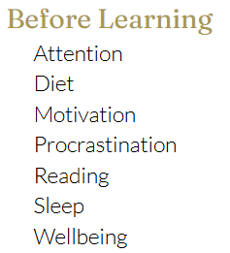
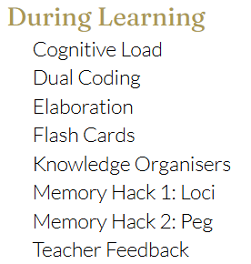
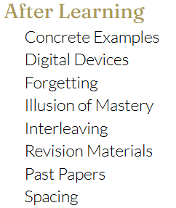
The ‘Hive Mind’ - Contribute!

Slide 31
Smart Learning School
Link here
Dan Conley
Founder
smartlearningschool.com
contact@smartlearningschool.com

